Slide 1
First year practicals
Lab 2: Sternberg (1966) How we search our memory

Slide 2
Objectives of this class
In this class you will learn about;
The key components of an experiment in PsychoPy’s Builder view
Sternberg’s study of short-term memory

Slide 3
PsychoPy basics
There are two PsychoPy ways to create experiments in PsychoPy;
you can write scripts in the Coder view that control the presentation of your stimuli
you can create an experiment visually in Builder view and use that either to run the experiment or to generate a script that you can then modify in Coder

Slide 4
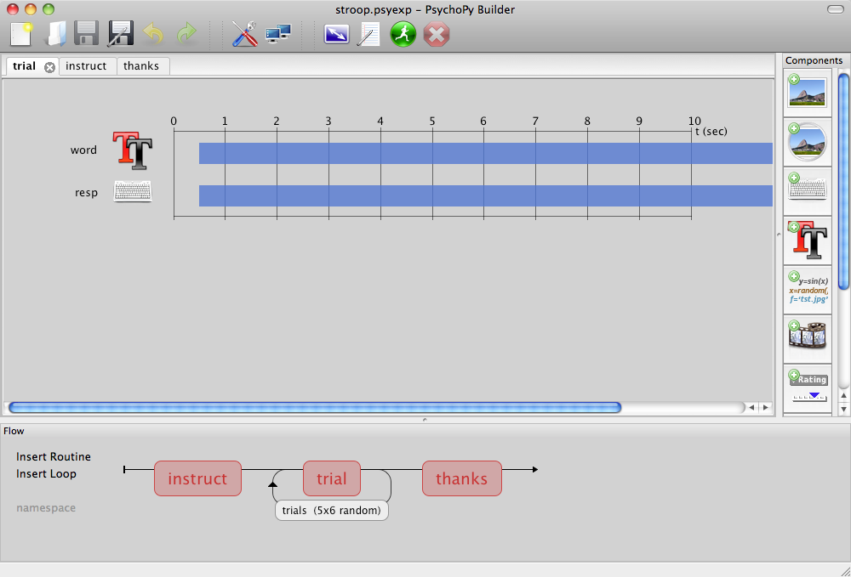
PsychoPy Builder
The builder view shows how an experiment runs.
It has Components that make up Routines that are combined in a Flow
Notes:
NB. This screenshot was taken under OS X running PsychoPy 1.62. The app will probably look slightly different on your machine.

Slide 5
PsychoPy Routines
Routines control the precise timing between Components (e.g. stimuli).
The Routine shown here has a text stimulus and records a keyboard response. This is all that was needed for a single trial in the Stroop task.
Notes:
Experiments can have many Routines,

Slide 6
PsychoPy Flow
The Flow in PsychoPy determines the way Routines will be combined and/or repeated.
The Flow can contain loops controlling how a Routine (e.g. a trial) is repeated, both in terms of how many repeats are made and how things change from one trial to the next
Notes:
Experiments can have many Routines,

Slide 7
PsychoPy controls
The top bar of PsychoPy shows some basic controls.
Most buttons and entry boxes in PsychoPy will give you a ‘tooltip’ if you hover the mouse over them.
Most dialog boxes have a help button too that will take you to more information online.
Notes:
Experiments can have many Routines,

Slide 8
PsychoPy Components
The Components in PsychoPy are things like stimuli and response devices (e.g. keyboard) that make up the experiment.
When you click on the icons on the right a Component will be added to the current Routine. They each bring up a dialog so you can configure them…

Slide 9
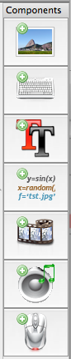
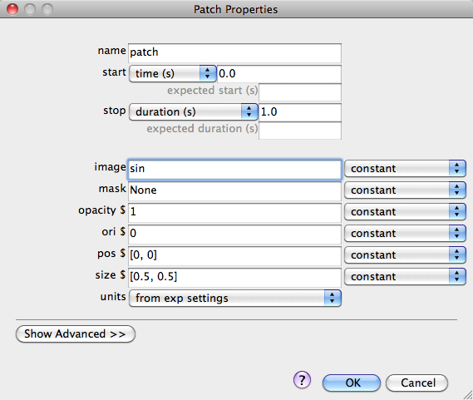
Patch Component
This allows you to present a patch of something; a picture, or a piece of ‘texture’
The image setting allows you to specify an image file to use or will present a sinusoidal ‘grating’ otherwise
The mask allows you to set a shape that the image will be seen ‘through’ e.g. a circle or a Gaussian window
Notes:
The sinusoidal ‘grating’ default is because PsychoPy was originally designed by a vision scientist, and they use that sort of thing all the time!

Slide 10
Common settings
Many of the settings are used by lots of Components (including the Patch):
start time (seconds) – the time after the start of the Routine that the stimulus will first appear
duration (seconds) – the length of time it will last. If blank then the Component will go on indefinitely
expected start/duration – has no effect on the experiment but can help PsychoPy represent your component on the timeline
units – this determines how the size and position are specified (see the online doc for further info)
pos – the position on the screen in the given units. [0,0] is the centre of the screen
size – the size of the stimulus
ori (degrees) – most visual stimuli can be rotated on the screen

Slide 11
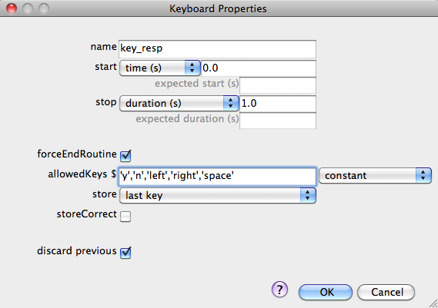
Keyboard Component
Receive input from the keyboard
Also has a startTime and duration (e.g. you may not want the subject to respond before the stimulus appears)
If allowedKeys is blank any key can be used
You can choose what you want to store about the keys and whether you want the Routine to end when a key is pressed
Response time (if needed) is taken from the startTime
NB. If you want to storeCorrect (i.e. store whether the subject pressed the correct key) you need to tell PsychoPy what the ‘correct’ key is

Slide 12
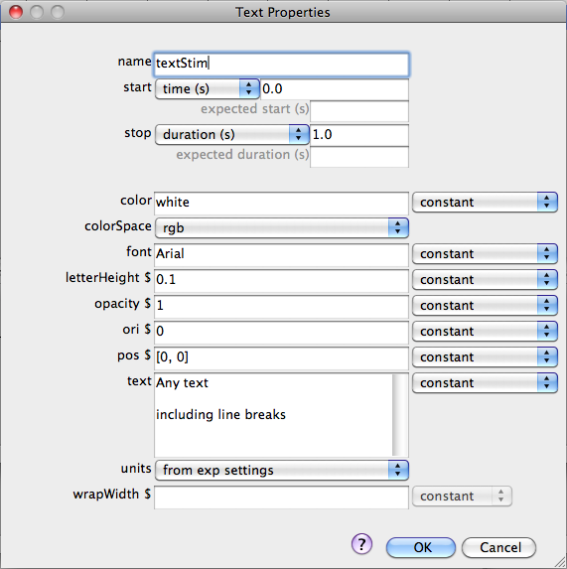
Text Component
For displaying text on the screen
letterHeight is used here instead of size
For color you can give a named colour from this list or you can specify a ‘hex’ value (e.g. #EE3A8C for a strong pink) or many other ways
You don’t need to set the colorSpace if using names or hex values
Notes:
‘This list’ refers to the X11 color names wikipedia entry: http://en.wikipedia.org/wiki/X11_color_names.
Only need to set color space if using these:
RGB e.g. $[-1,1,-1]
RGB256 e.g. $[0,255,0]
DKL and LMS are special spaces requiring a calibrated monitor

Slide 13
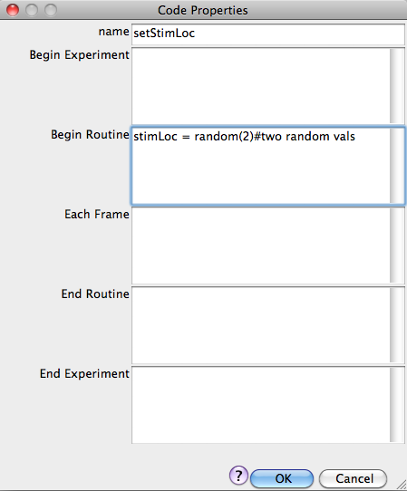
Code Component
The code component is a little more advanced
It allows us to create custom variables that can be used by other components
These can be set at different points in the experiment and used by components with settings starting “$”
e.g. we could set some text to appear at pos=$stimLoc and the code shown here will make it random on each repeat of the Routine
Notes:
NB the Code Component must be HIGHER than anything in the Routine that wants to use it. You can move things up and down the Routine by right-clicking them

Slide 14
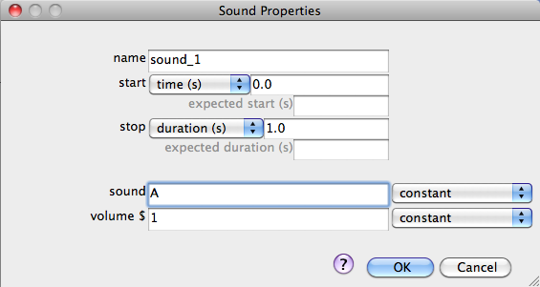
Sound Component
No prizes for guessing what a Sound Component does
In the sound setting you can specify;
a note name (e.g. A, Bfl, Csh)
a frequency in Hz (e.g. $440)
or a filename for a wav, mp3 or mp4 file. If the sound is a file then set duration to be blank

Slide 15
PsychoPy and the $
What was the $ for?
most PsychoPy inputs are interpreted as text
the $ symbol announces that this is not text
that’s important if you need to specify that the value is;
a variable name
a number
a list of values (e.g. for RGB colors, $[1,-1,-1] refers to red)

Slide 16
Component names
In PsychoPy almost everything you create needs to be given a name
The name must;
be unique
not contain spaces, punctuation (except underscore _) or mathematical symbols
e.g. if you have a Routine called ‘feedback’ you can’t have a Text Component called ‘feedback’

Slide 17
Routines
You can have as many Routines as you like (they also need names, following the same rules)
Create them by going to the menu item >Experiment>New Routine…
You can switch between your Routines by selecting the different tabs
If you want to edit a Component that you’ve added, click on it with the mouse
If you want to remove a Component right-click on it and select ‘remove’

Slide 18
Using the Flow
You can combine Routines in the Flow panel
To add one of your Routines to the Flow (you must create it first) click on “Insert Routine” in the Flow panel and select where you want it to go
If you want something to repeat (e.g. to run multiple trials) then you can “Insert Loop” and select the points where you want to start/finish
loops can span across multiple Routines
loops can nest (you can have loops around loops)
Loops and Routines can also be edited or removed form the Flow by clicking or right-clicking

Slide 19
Setting trial types (conditions)
Usually when you repeat trials you want things (‘parameters’) to change from one to the next
This is handled by the Loops that you set in the flow
When you insert (or edit) a Loop you can can select a conditionsFile in the dialog box
This file is an Excel (2007) file that has one row for each type of trial and one column for each parameter
Parameters can then be accessed by components using $ and can change on each repeat through the loop

Slide 20
Sternberg (1966)

Slide 21
Sternberg’s (1966) study of short-term memory (STM)
Saul Sternberg was trying to understand how memory is accessed by measuring reaction times during memory tasks
In the study we will look at today, the aim was to determine;
whether we search our STM in a serial or parallel fashion
whether the search stops when the desired item is located (a ‘self-terminating’ search), or whether it continues to check all available items (an ‘exhaustive’ search)

Slide 22
Sternberg’s Task
The participant is given a list of from one to six digits
These digits are called the memory set
The participant is allowed to rehearse this list
A few seconds later, the participant sees a single digit
This number is called the probe
The participant must indicate whether the probe digit is or is not a member of the memory set

Slide 23
Serial vs. Parallel Search
If you search serially, then the more items there are to search, the longer it should take.
RT should increase as the memory set size increases.
If you can search all the items at once, it should not matter how many there are
RT should be the same for any memory set size (up to the capacity of STM).
Does RT increase with memory set size or not?

Slide 24
Exhaustive vs. Self Terminating Search
If the search is serial then we can also investigate whether it is self-terminating
Negative probe trials require an exhaustive search always; the participant has to check every item to confirm that the target was absent
On positive probe trials we might also search the set exhaustively, in which case the –ve and +ve probe trials will have equal RTs
Or the search could self-terminate, in which case RTs will be less for the conditions where the probe was actually present

Slide 25
Predictions
Serial, self-terminate
Parallel search
Serial exhaustive
Target absent
RT
(ms)
Target present
Set size (N)
Set size (N)
Set size (N)
(All trials equally fast)
(Should be quicker if target is present, because stop searching)
(If always inspecting every value, then it doesn’t help that we found target before end!)

Slide 26
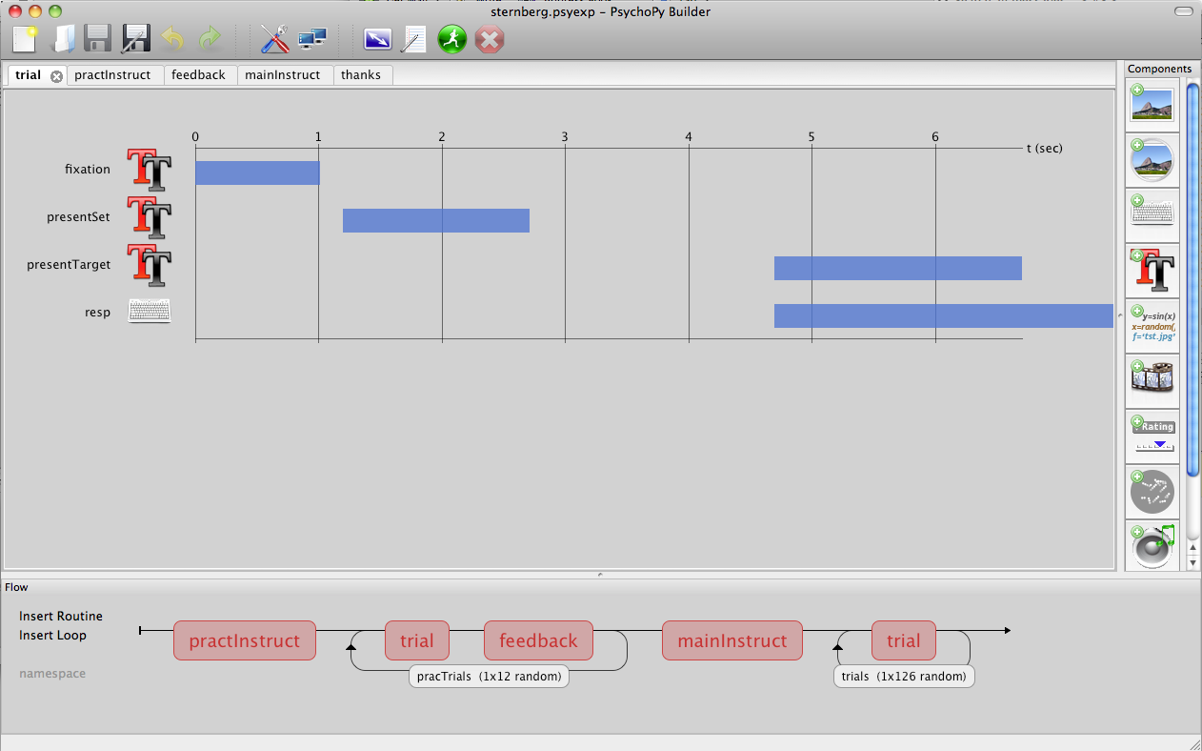
Sternberg in PsychoPy
You can see the main timing of the Sternberg trials above. A set of letters will follow a fixation target, then a pause, then a probe and response

Slide 27
An example: Sternberg
Then, from the Flow, you can see how the Routines fit together
Note that;
the trial Routine gets used in multiple places (if the routine is identical it can be reused)
the pracTrials loop spans two Routines; a trial, then feedback, then loops back for the next trial

Slide 28
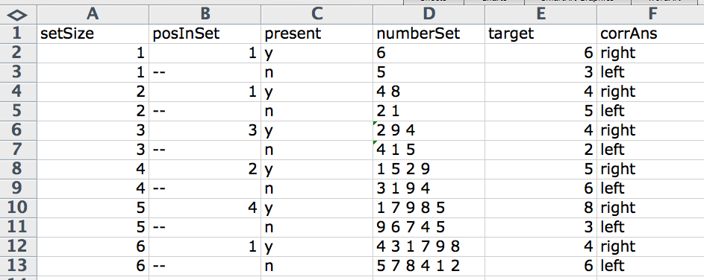
Sternberg trial types
The Excel file specifying the (practice) trial parameters looks like this
(The one for the main trials is similar but with more different sets of numbers)

Slide 29
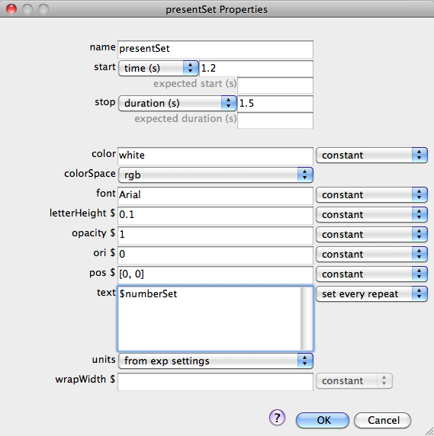
Examining component properties
Select the trial Routine and click on text icon for the presentSet component to see its properties. This is what presents the set of numbers to be remembered
The text to be displayed comes from the numberSet column in the Excel file attached to the loop
It will be updated every repeat of the Routine

Slide 30
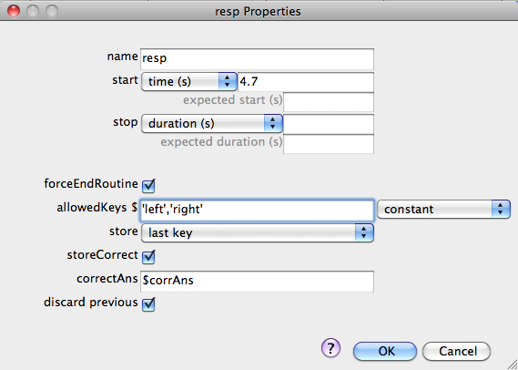
Examining component properties
Now click on the keyboard icon next to resp to see the properties of the keyboard response input.
Give the subjects unlimited time but store RT, starting from the moment the stimulus is presented (t=4.7sec)
The corrAns variable was also a column in the Excel file specifying the parameters

